Slide 1
CHINESE AUTOMOBILE COMPANY GEELY AUTO PREDICTION OVERVIEW

Slide 2
Name: blessing john contracted data scientist

Slide 3
Objectives
The project is aimed at building a machine learning model to predict the most influential factors to the prices of different car brands in the Nigeria Automobile Industry and to help management accordingly manipulate the design of the cars, the business strategy etc. to meet certain price levels.

Slide 4
Data overview
Car_ID - Unique id of each observation (Interger) Symboling - Its assigned insurance risk rating, A value of +3 indicates that the auto is risky, -3 that it is probably pretty safe.(Categorical) carCompany - Name of car company (Categorical) fueltype - Car fuel type i.e gas or diesel (Categorical) aspiration - Aspiration used in a car (Categorical) doornumber - Number of doors in a car (Categorical) carbody - body of car (Categorical) drivewheel - type of drive wheel (Categorical) enginelocation - Location of car engine (Categorical) wheelbase - Weelbase of car (Numeric) carlength - Length of car (Numeric) carwidth - Width of car (Numeric) carheight - height of car (Numeric) | curbweight - The weight of a car without occupants or baggage. (Numeric) enginetype - Type of engine. (Categorical cylindernumber - cylinder placed in the car (Categorical) enginesize - Size of car (Numeric) fuelsystem - Fuel system of car (Categorical) boreratio - Boreratio of car (Numeric) stroke - Stroke or volume inside the engine (Numeric) compressionratio - compression ratio of car (Numeric) horsepower - Horsepower (Numeric) peakrpm - car peak rpm (Numeric) citympg - Mileage in city (Numeric) highwaympg - Mileage on highway (Numeric) price(Dependent variable) - Price of car (Numeric)

Slide 5
Univariate analysis

Slide 6
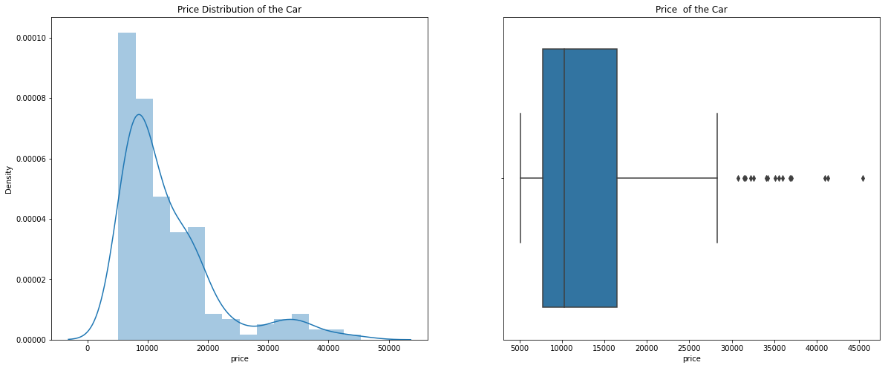
Univariate analysis - distribution of car price

Slide 7
Observation
The price plot shows a trend in most purchase of cars as most cars purchased were between the prices of 5000 – 10, 000. This is important feature to be noted as cheap cars sells more as compared to expensive cars in the range of 40000 – 45000.
The data points are far spread out from the mean, which indicates a high variance in the car prices.(85% of the prices are below 18,500, whereas the remaining 15% are between 18,500 and 45,400.)

Slide 8
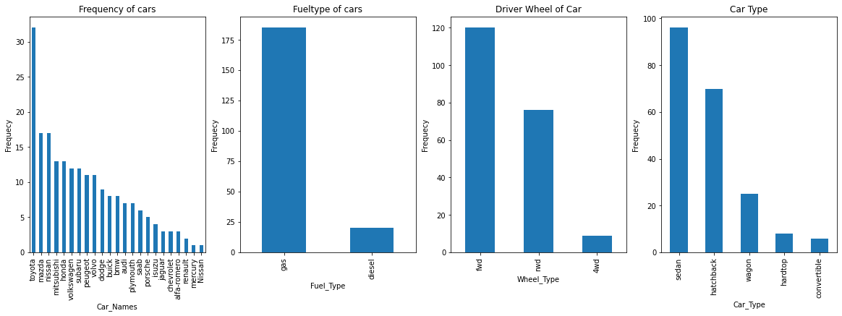
Univariate analysis - distribution of car type, fueltype, driver wheel and car names

Slide 9
Observation
Toyota seemed to be favored car company.
Number of gas fueled cars are more than diesel.
From the distribution plot of car fuel type, it was seen that more car type purchased in the car are fuel gas powered cars rather than diesel as the plot shows a significant difference.
sedan is the top car type prefered..
fwd is the prefered wheel type

Slide 10
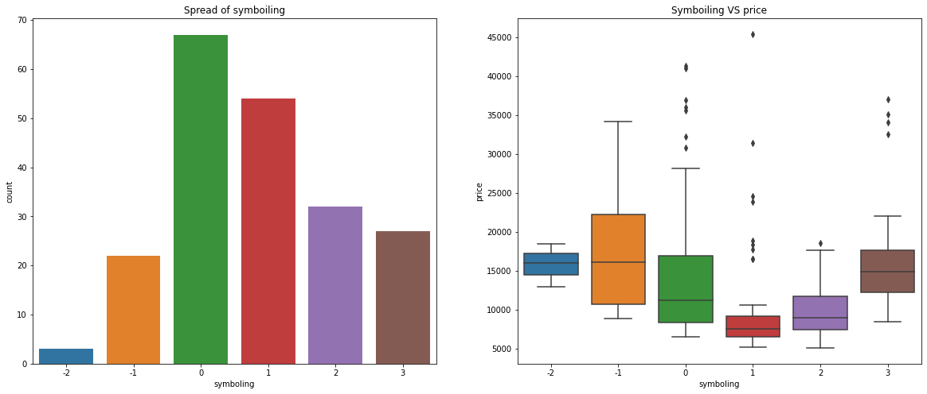
Univariate analysis – symbolling vs price

Slide 11
Observation
It seems that the symboling with 0 and 1 values have high number of rows (i.e. They are most sold.)
The cars with -1 symboling seems to be high priced (as it makes sense too, insurance risk rating -1 is quite good). But it seems that symboling with 3 value has the price range similar to -2 value. There is a dip in price at symboling 1.
To the insurance risk rating plot, it is seen that major of the car produced has a IRR of greater +1 which is risky as compared to the number of car -1 that are safe as the data shows a margin level greater than 70% as risky.

Slide 12
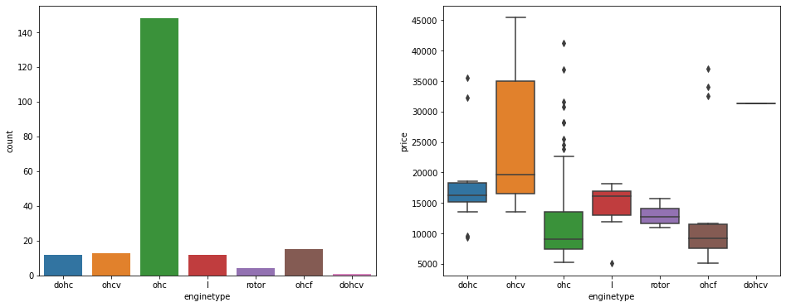
Univariate analysis - distribution of engine type

Slide 13
Observation
ohc Engine type seems to be most favored type.
ohcv has the highest price range (While dohcv has only one row), ohc and ohcf have the low price range.

Slide 14
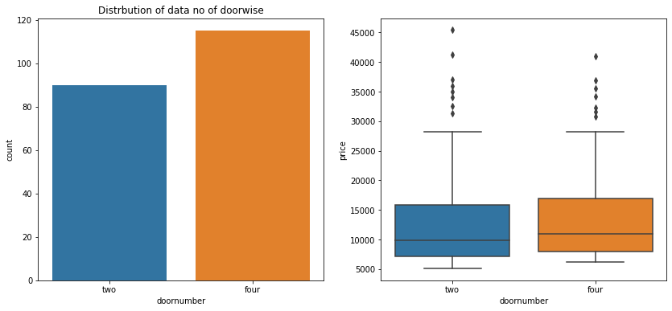
Univariate analysis - distribution of door numbers.
.

Slide 15
observation
doornumber variable is not affecting the price much. There is no significant difference between the categories in it, but cars with four doors are most preffered
On the number of car produced with doors, the data shows that majority of the cars are usually 4 doors automobile as there is little difference between both four doors and two doors.

Slide 16
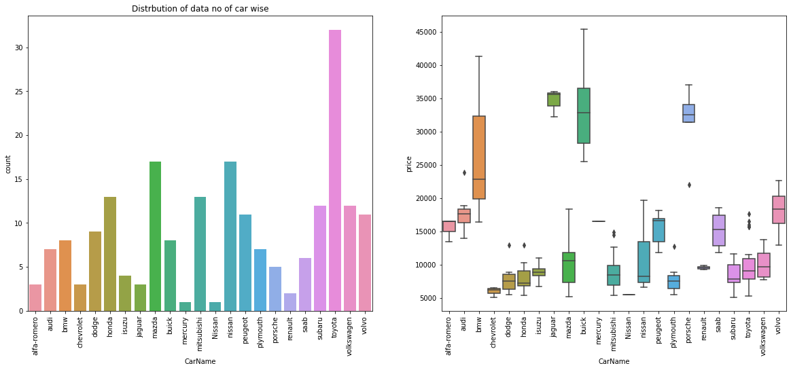
Univariate analysis: distribution of the car name

Slide 17
observation
Toyota seemed to be favored car company.
Jaguar and Buick seem to have highest average price

Slide 18
Bivariate analysis

Slide 19
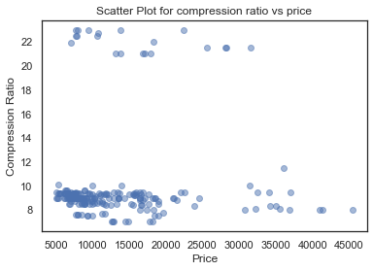
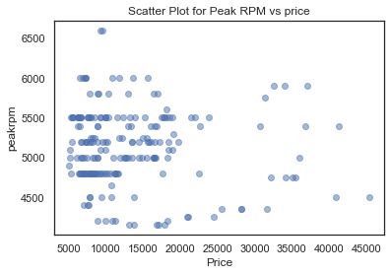
Bivariate analysis

Slide 20
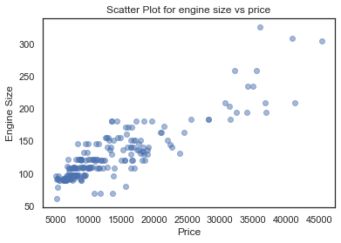
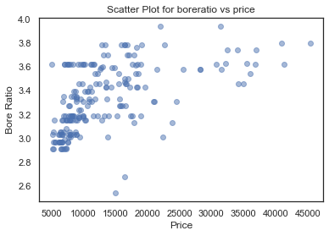
Bivariate analysis

Slide 21
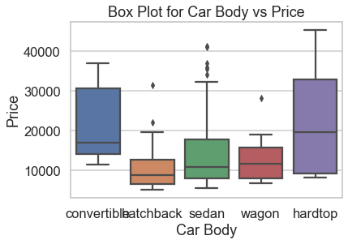
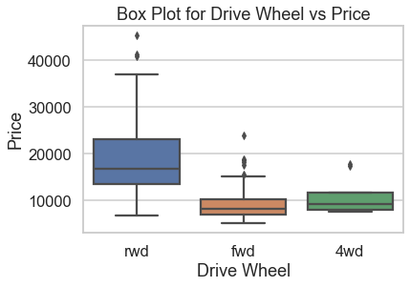
Bivariate analysis

Slide 22
Observation
From the comparison of compression ratio to price, it was observed that there is a concentration in the lower region around 8 - 10 of the compression ratio to 5000 - 20000 of the price with few observation in upper region of compression ratio of 22.
For the comparison of peakrpm and price, the exist a high density between 4800 and 5500 in peakrpm and 5000 to 15000.
Other variables shows a significant behaviour in comparison to price such as engine size, car body, bore ratio and drive wheel.

Slide 23
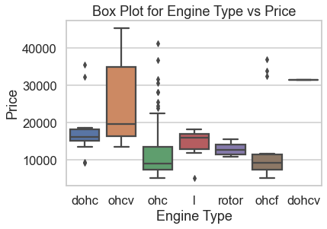
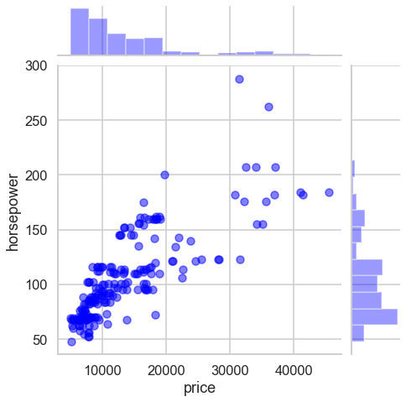
Bivariate analysis

Slide 24
multivariate analysis

Slide 25
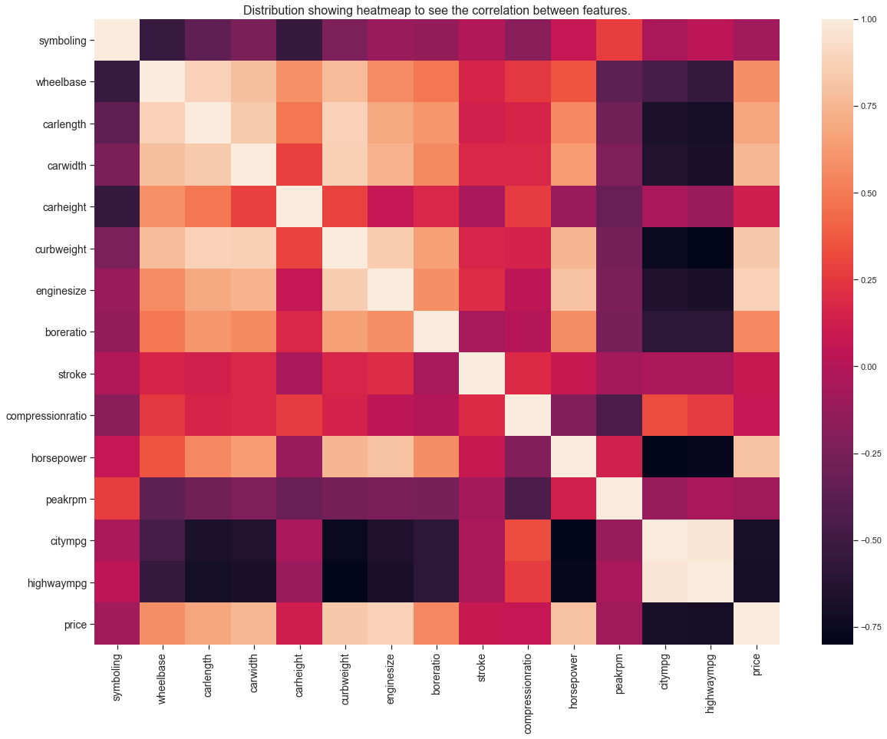
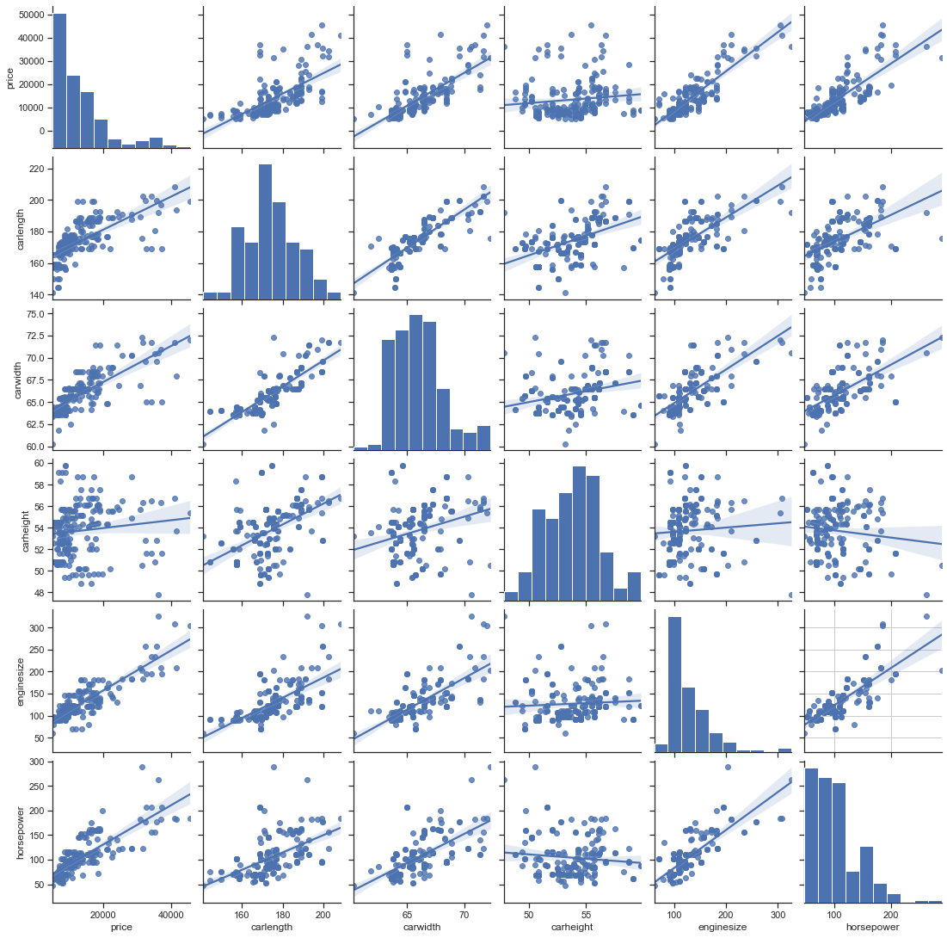
multivariate analysis

Slide 26
Observation
From observation, the heatmap shows a strong correlation between enginesize to horsepower, and price to enginesize and also price to carwidth and weak correlation between price to highwaympg and citympg.
NB: A coefficient close to 1 means that there's a very strong positive correlation between the two variables. The diagonal line is the correlation of the variables to themselves – so they'll, of course, be 1.

Slide 27
Ridge and Lasso Regression

Slide 28
Action and Recommendation
Ridge and Lasso regression was employed for the prediction of the variable dependent on influencing the price of car. The model gave a regression score of 91% with queried with the entire feature against prices as compared to a selection of dependent variable which give a regression score of 71%. That is to say, with proper investigation of individual variable, a more accurate regression score will be obtained and compared among each other to understand the dependent with more influence to the price of car in the Nigeria market.

Slide 29
Action and Recommendation cont’d
OLS model was also implemented to obtain the p-value and coef which from the results, it was observed that certain features plays a significant role in sales in the Nigeria markets such as aspiration, carheight, carwidth, boreratio, highwaympg, cylindernumber, enginesize and others with low p-value such as horsepower, highwaympg, wheelbase, enginetype, enginelocation and boreratio.
Concentration needs to be given to the doornumber, carbody, stroke and symboling as these feature if not properly handle could cost the company money in relation to competition among other car production company.

Slide 30
Thank you very much!!!.

